Slide 1

Summary and Overview
Payam Barnaghi
Department of Brain Sciences &
School of Convergence Science (Human and Artificial Intelligence)
Imperial College London
January 2026
Notes:
1

Slide 2
From Day 1: What you are going to learn in this module
Primary machine learning topics and concepts
Hands-on skills on how to:
Decide and choose suitable models
Design machine learning tasks/experiments
Choose and apply suitable metrics to evaluate the models
Identify and resolve common issues such as overfitting/underfitting

Slide 3
From Day 1: By the end of this module
You should be able to:
Construct machine learning experiments
Create and run different probabilistic/statistical learning and deep learning models
Read and interpret existing work and assess their applicability/validity [to different use cases]
Be familiar with common concepts such as training/test, cross-validation, performance evaluation metrics
Learn common issues and pitfalls in developing ML models
Obtain practical experience in developing ML models and running (simple) experiments.

Slide 4
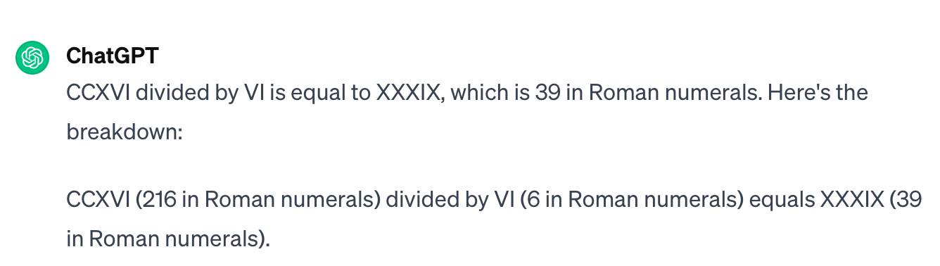
Data and representations
CCXVI divided by VI?
216/6?
via: Goodfellow et al., Deep learning

Slide 5
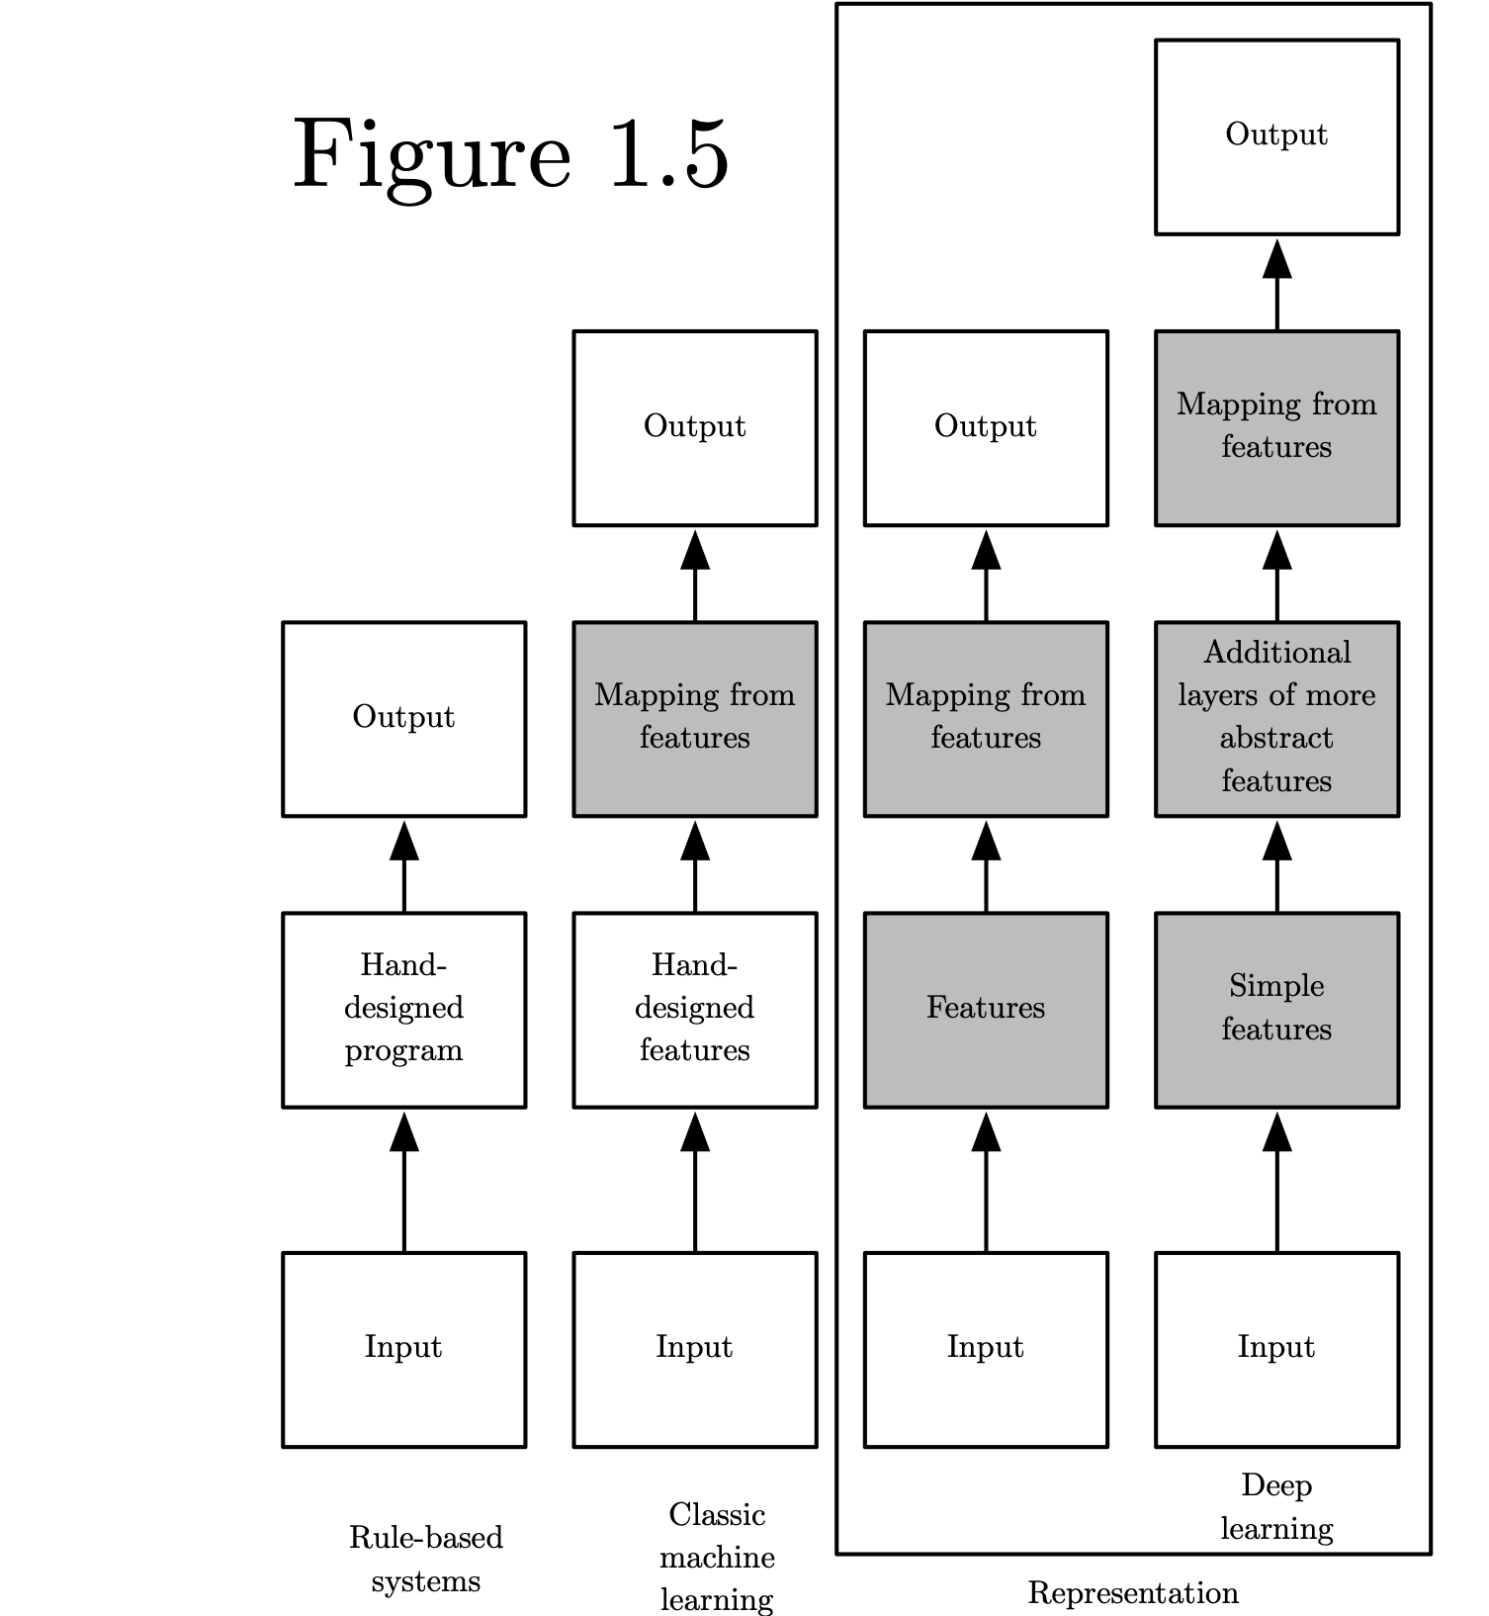
Categories of learning and intelligent systems
Source: Deep Learning, Ian Goodfellow et al, MIT press.

Slide 6
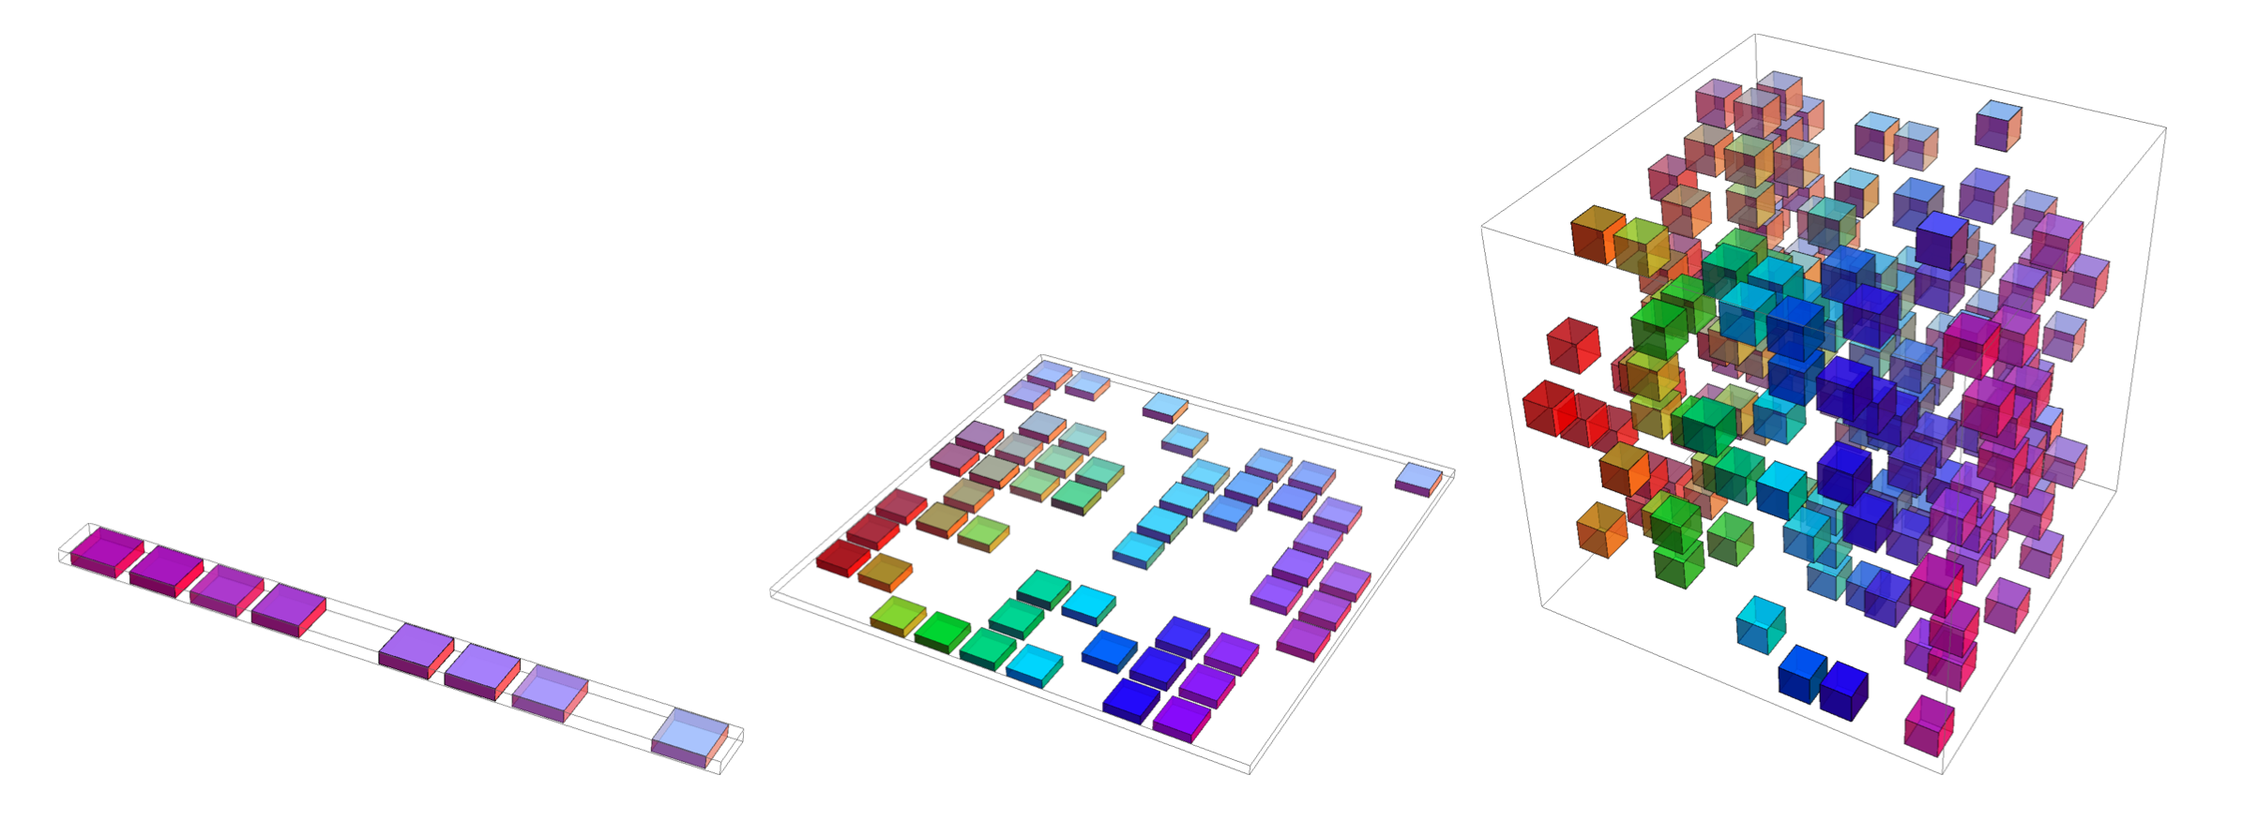
Curse of dimensionality
Overall, for d dimensions with v values we need O(v^{d}) regions and examples
Source: Deep Learning, Ian Goodfellow et al, MIT press.

Slide 7
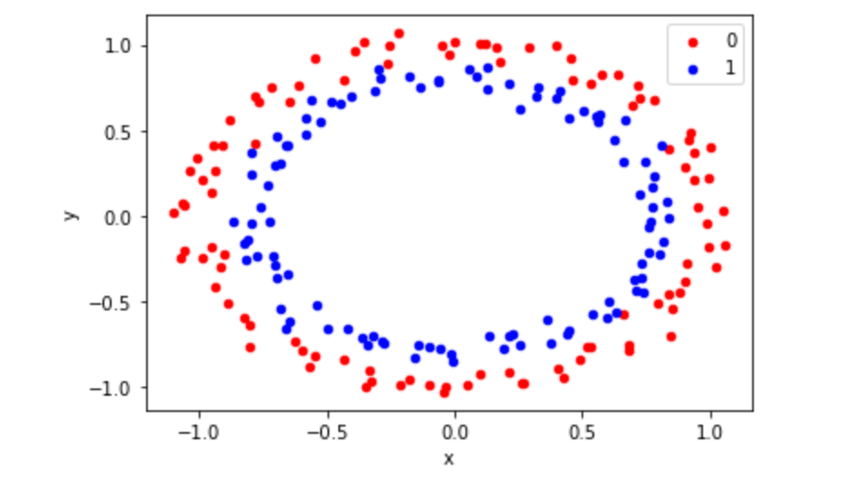
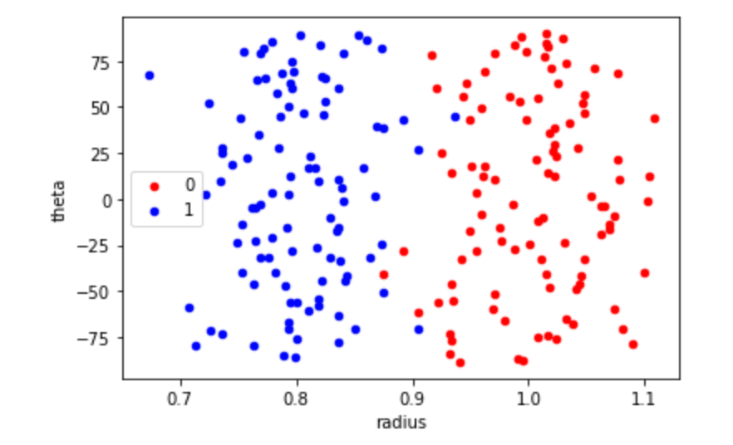
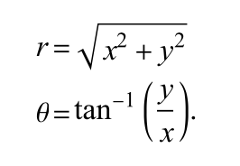


Data/sample representation
(x,y)
<Code>
https://github.com/PBarnaghi/Basic-ML-Code/

Slide 8
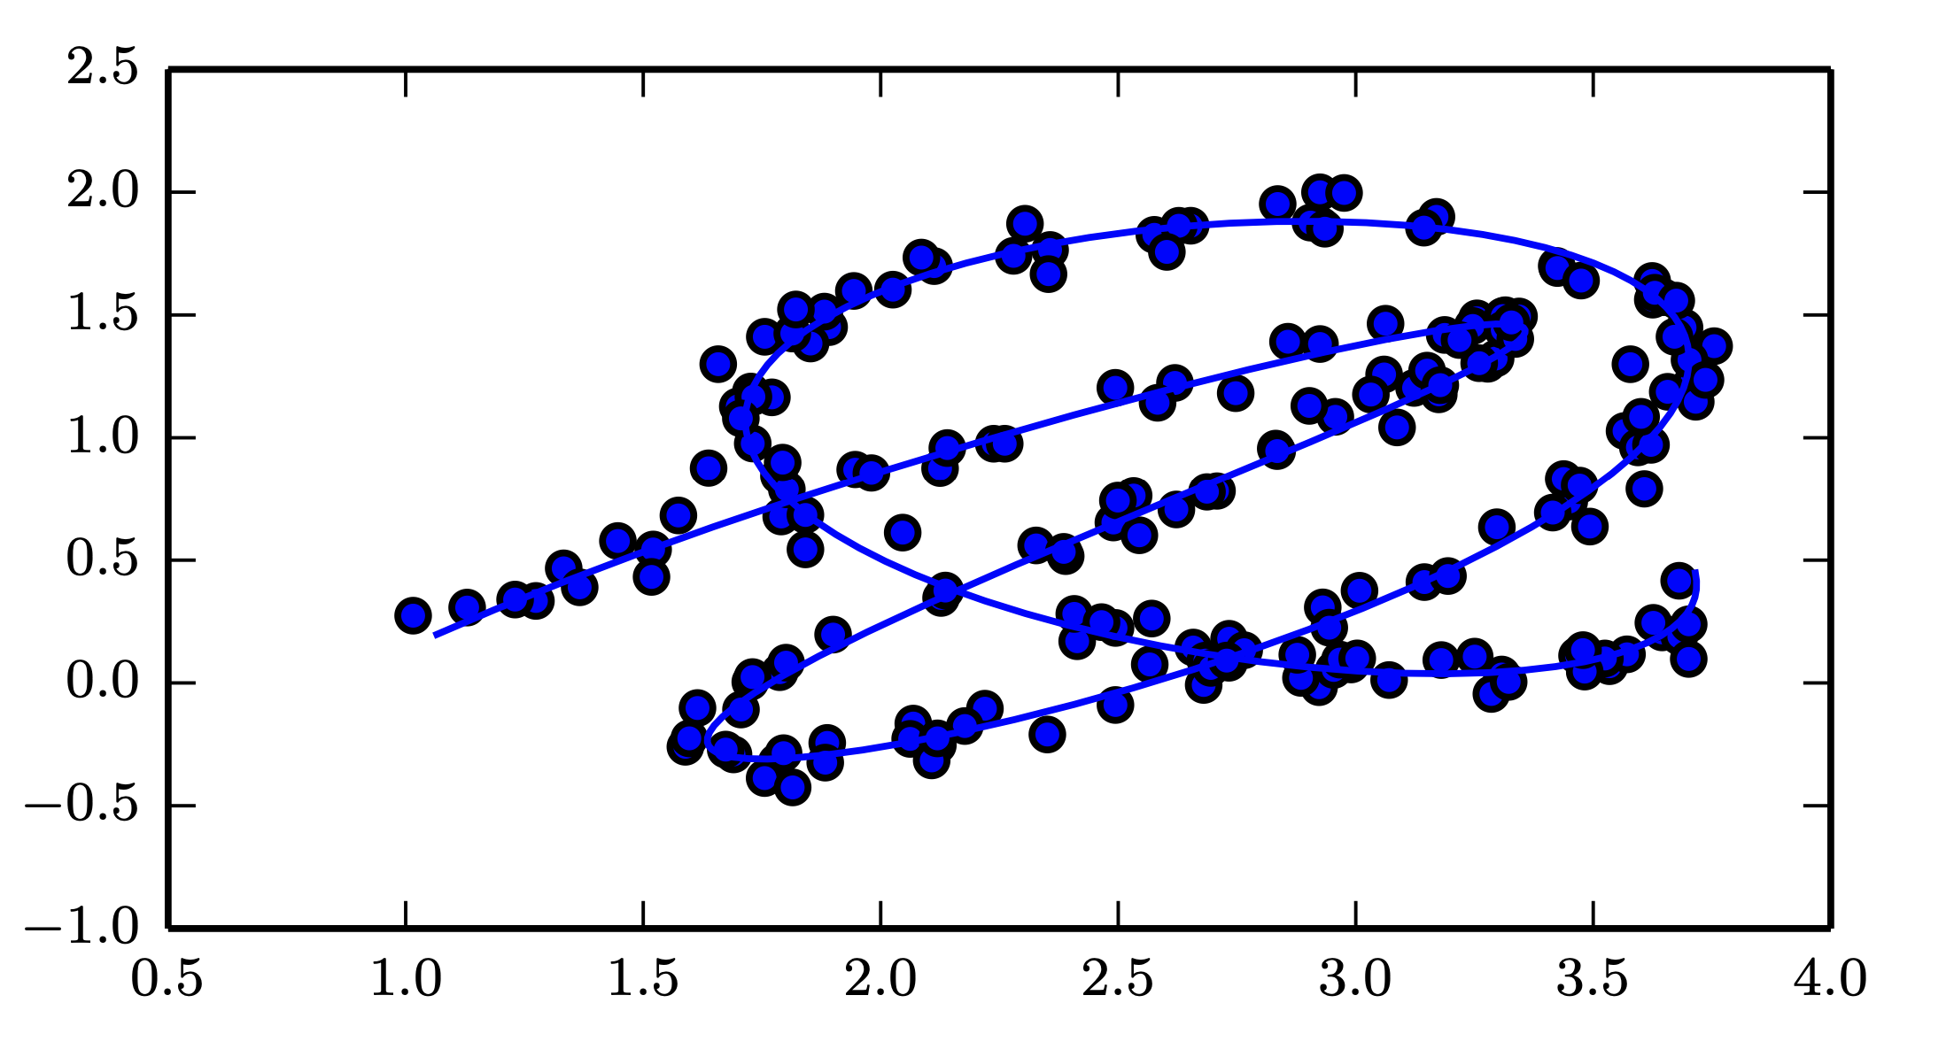
Manifold learning
Source: Deep Learning, Ian Goodfellow et al, MIT press.

Slide 9
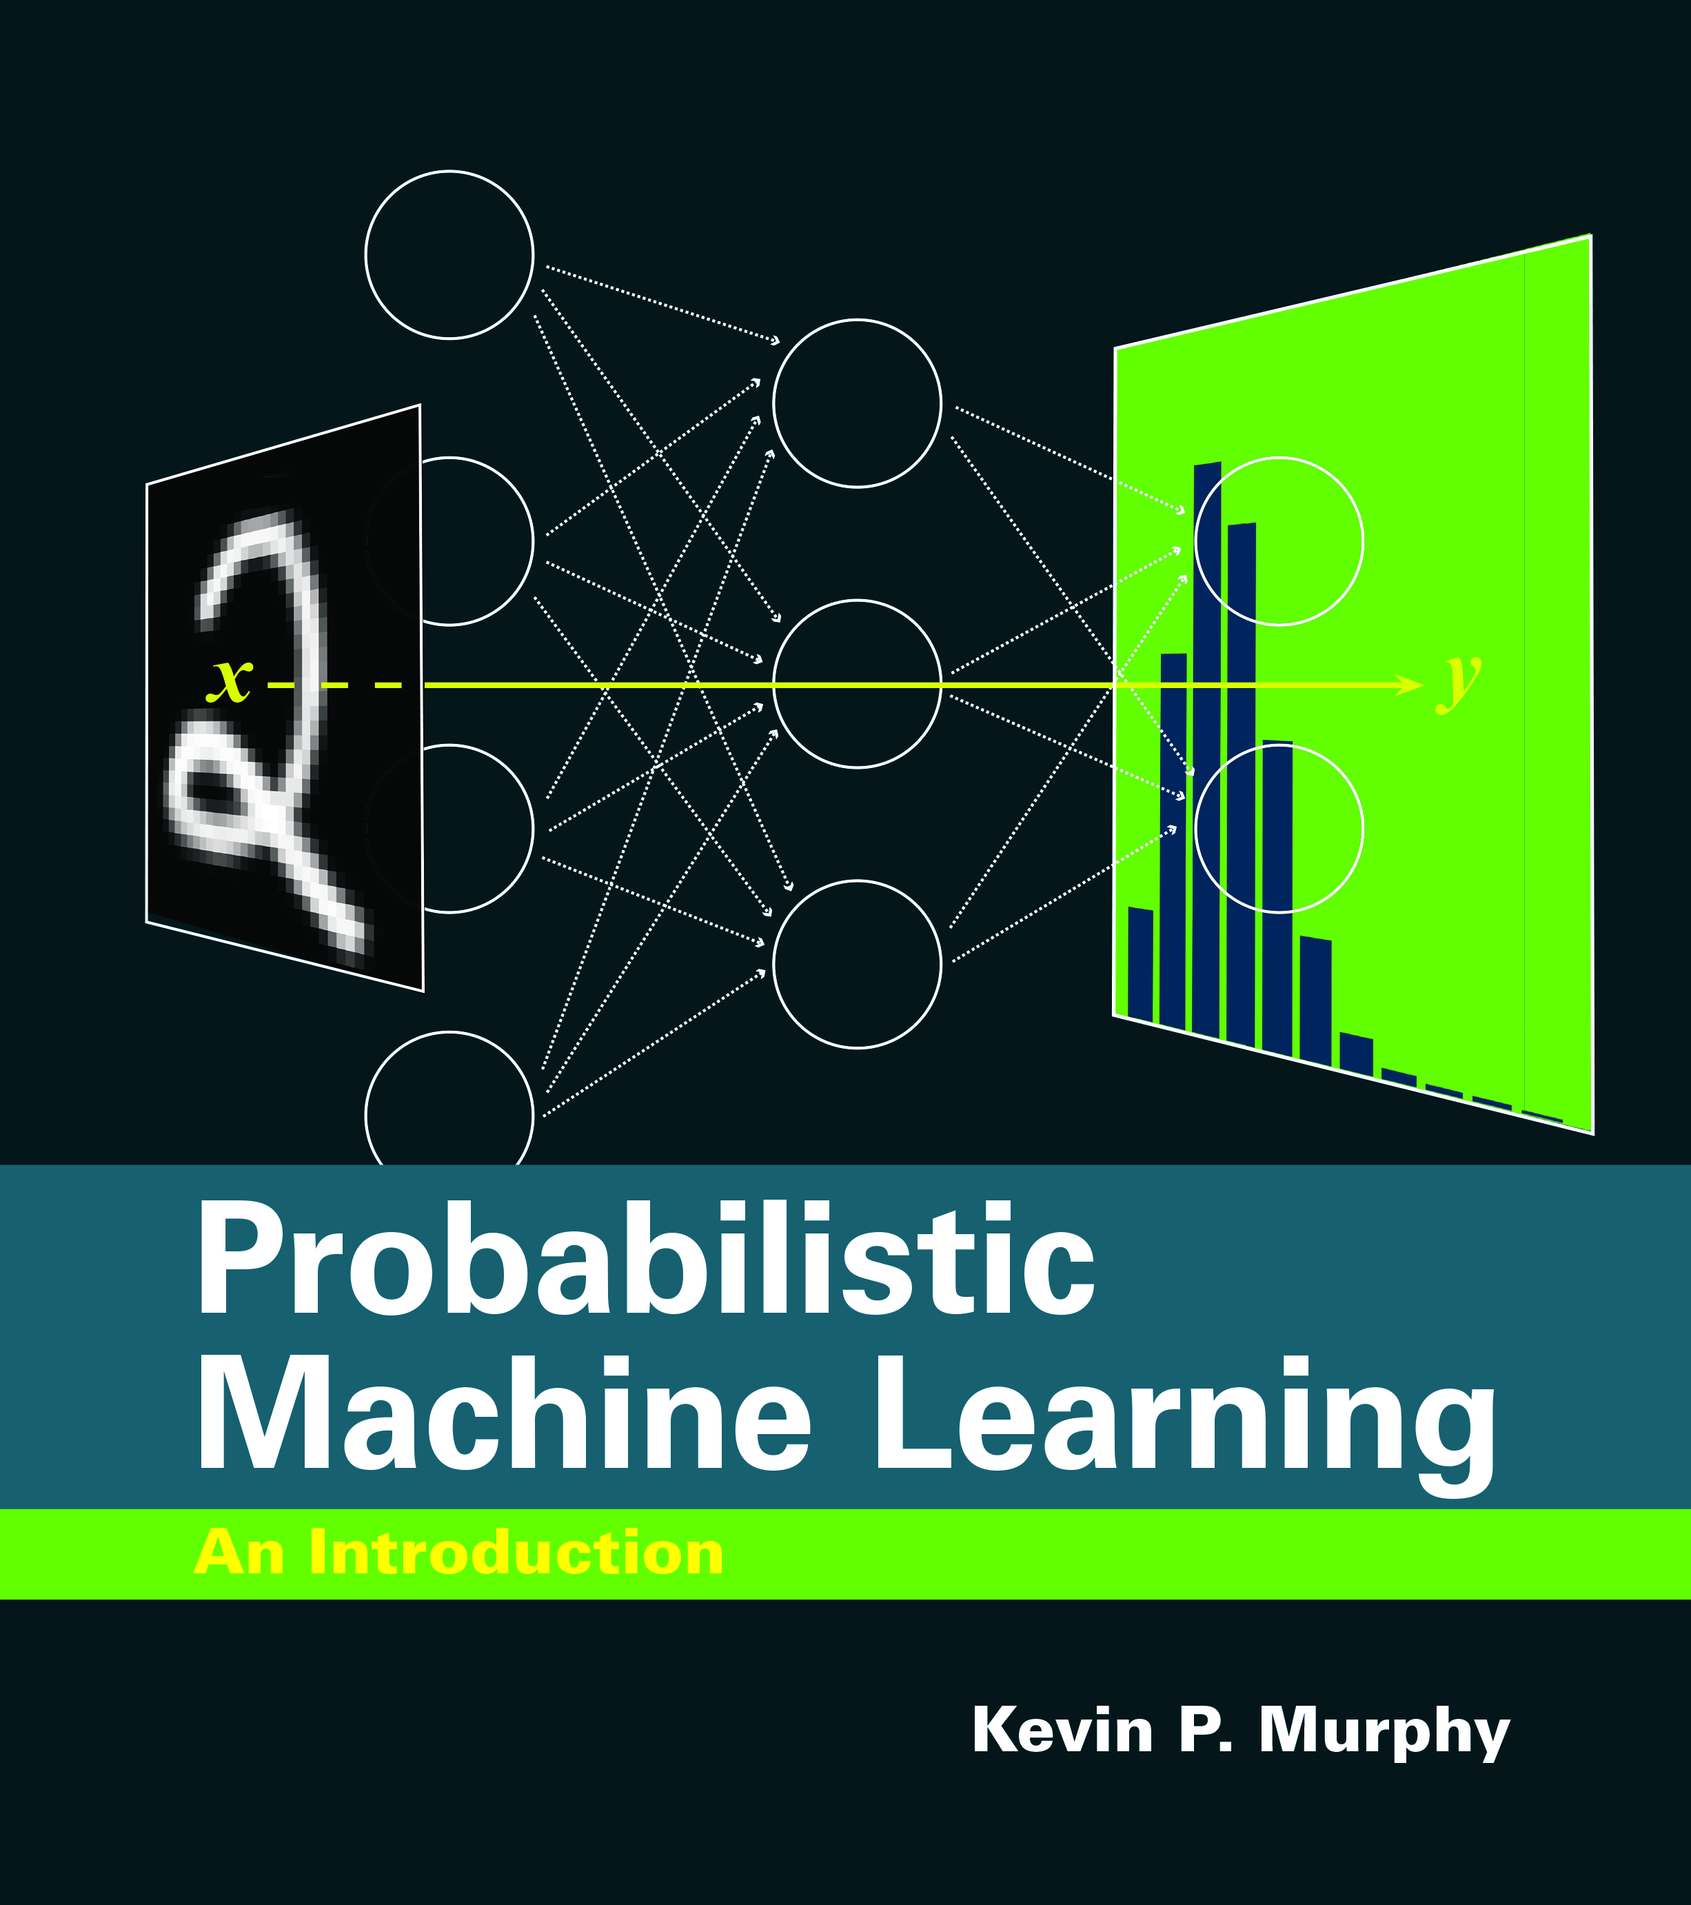
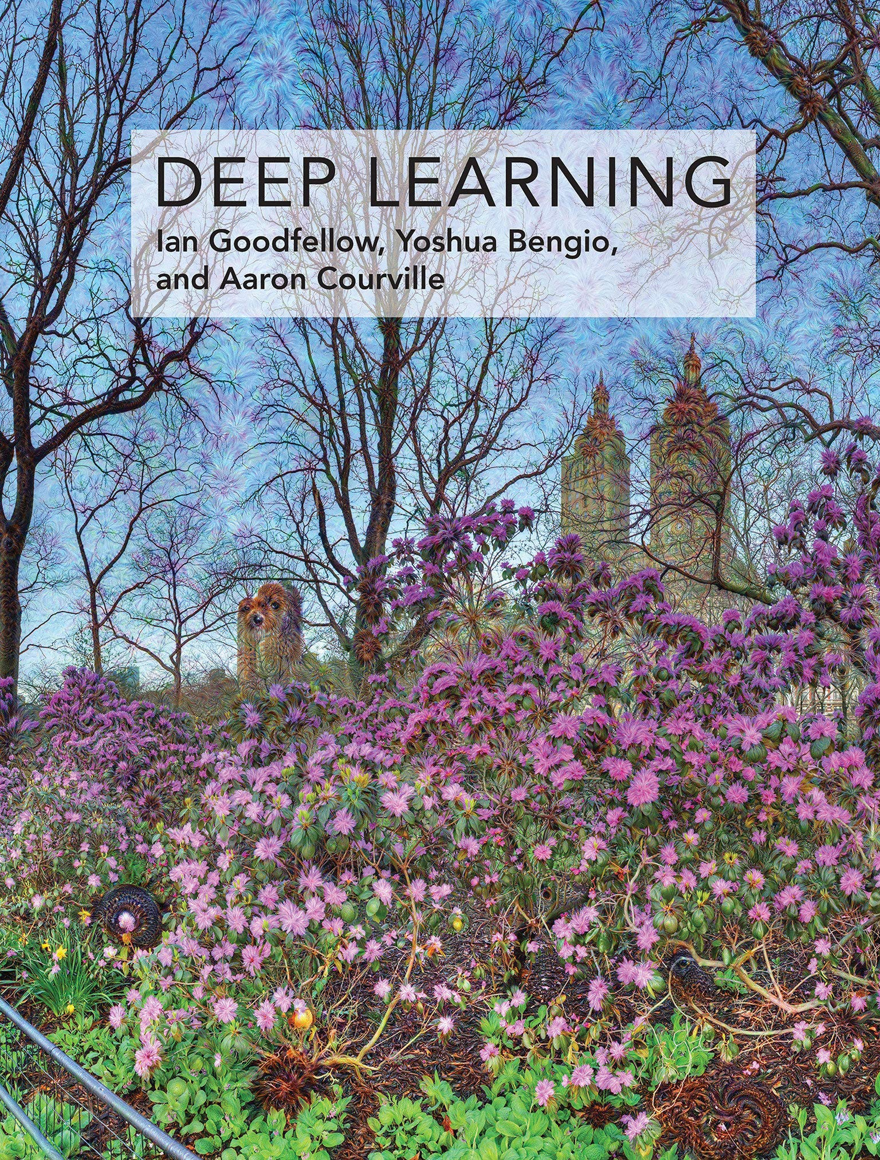
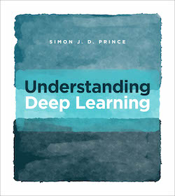
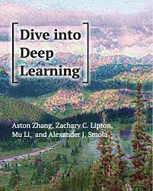
Reference and sources
Probabilistic Machine Learning Kevin P. Murphy, MIT Press
Deep Learning
Goodfellow et al., MIT Press
Understanding Deep Learning, Simon J.D. Prince, MIT Press
Dive into Deep Learning
Aston Zhang et al.
Preprints:
Probabilistic Machine Learning: An Introduction, https://probml.github.io/pml-book/book1.html
Deep learning: https://www.deeplearningbook.org
Understanding Deep Learning, https://udlbook.github.io/udlbook/
Dive into deep learning, https://d2l.ai/index.html

Slide 10
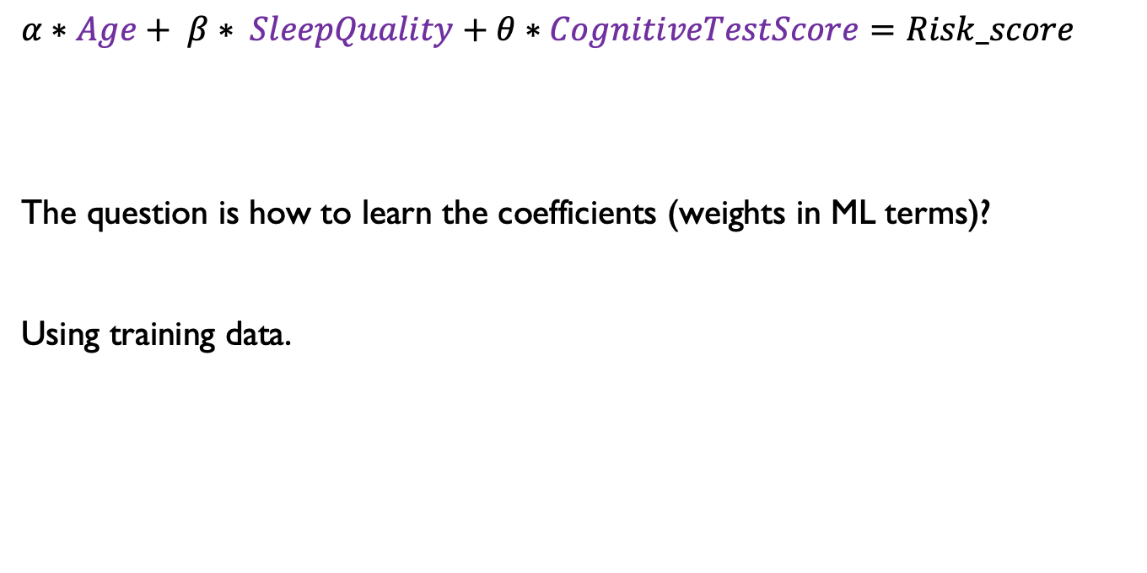
Linear models - training
$α∗Age+ β∗ SleepQuality+θ∗CognitiveTestScore=Risk_score$
The question is how to learn the coefficients (weights in ML terms)?
Using training data.

Slide 11
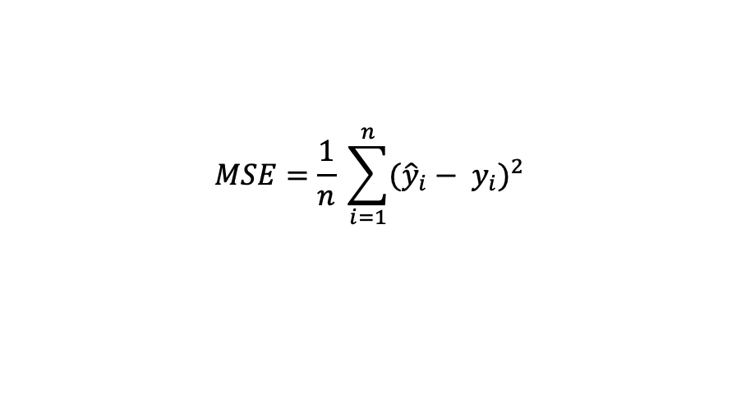
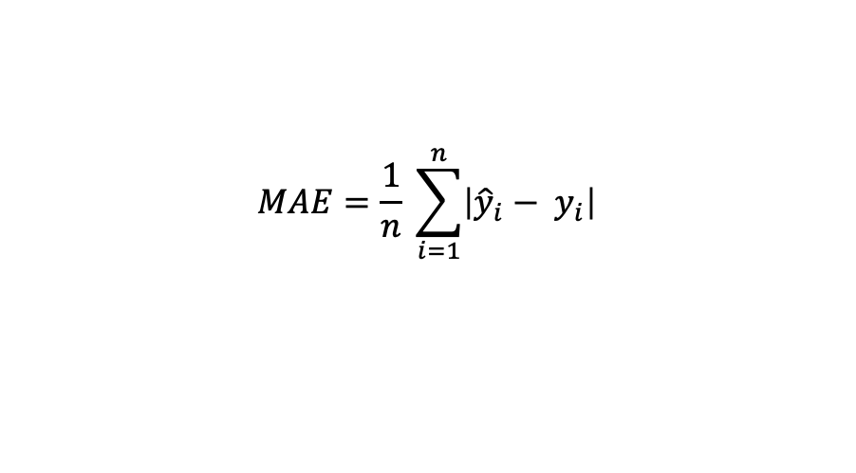
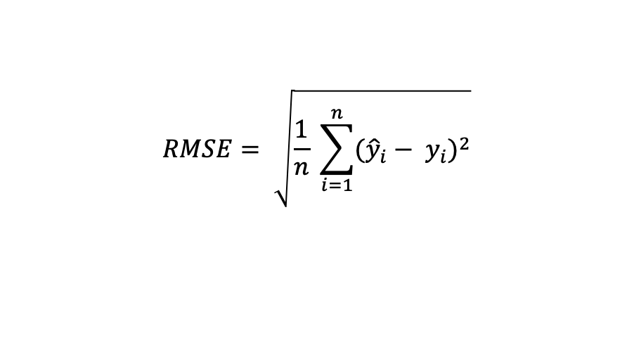
How to evaluate your LR model
$$MAE=\frac{1}{n} \sum_{i=1}^{n}{\left|{\hat{y}}_{i}− y_{i}\right|}$$
Mean Absolute Error (MAE)
Mean Squared Error (MSE)
Root Mean Squared Error (RMSE)
$$MSE=\frac{1}{n} \sum_{i=1}^{n}{{({\hat{y}}_{i}− y_{i})}^{2}}$$
$$RMSE= \sqrt{\frac{1}{n} \sum_{i=1}^{n}{{({\hat{y}}_{i}− y_{i})}^{2}}}$$

Slide 12
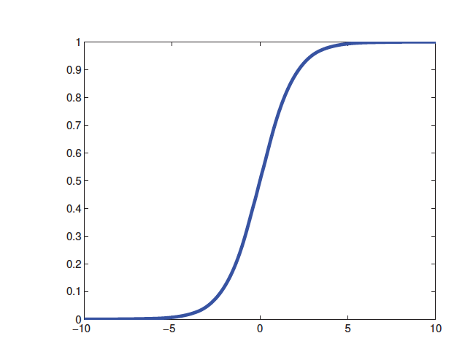
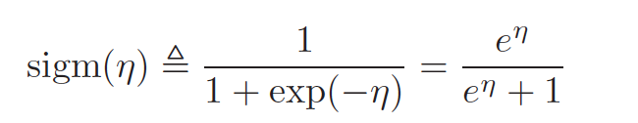
Logistic regression
The process of applying a linear combination of the inputs, as before, but then we pass this through a logistics function, is called logistic regression due to its similarity to linear regression (although it is a form of classification, not regression!).

Slide 13
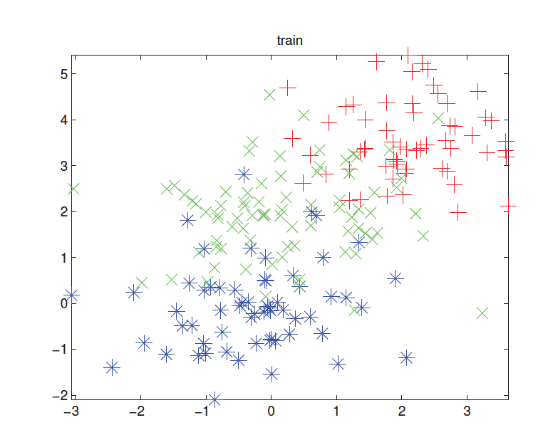
K-nearest neighbours - example

Slide 14
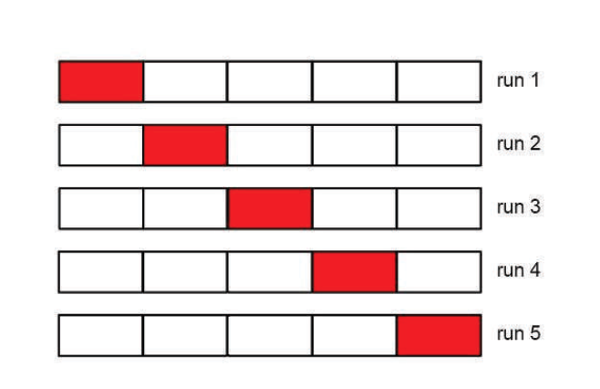
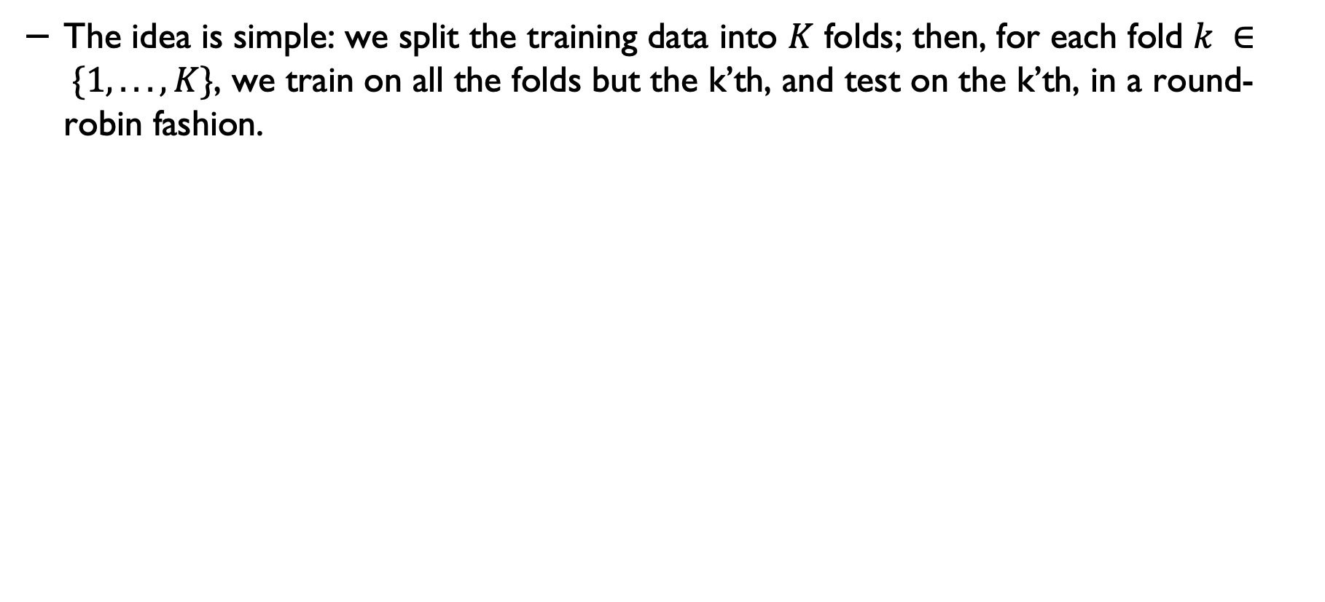
Cross validation
The idea is simple: we split the training data into $K$ folds; then, for each fold $k ∈ \{1, . . . , K\}$, we train on all the folds but the k’th, and test on the k’th, in a round-robin fashion.

Slide 15
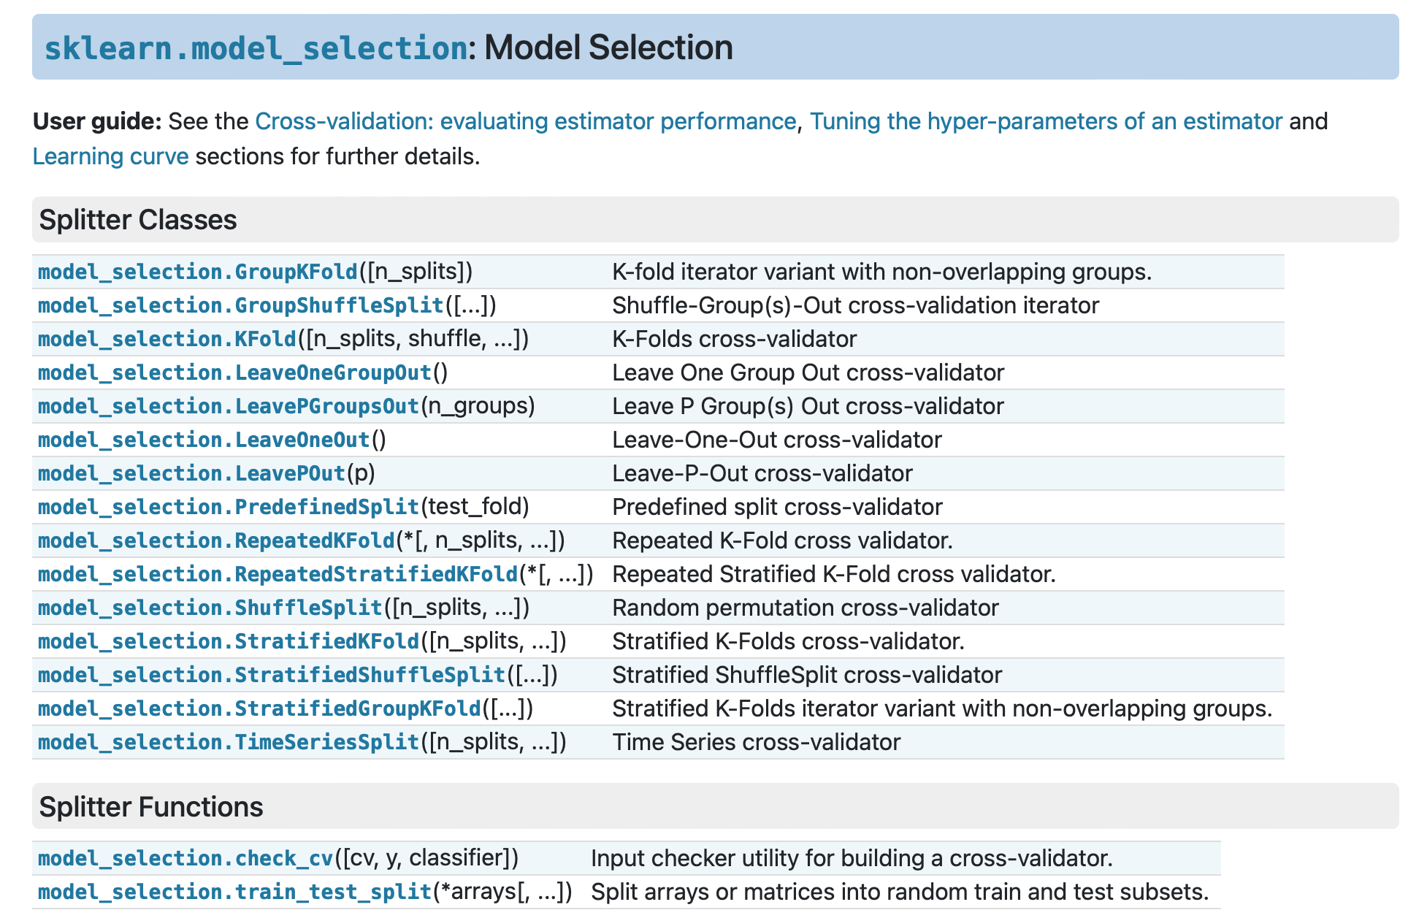
Cross validation - in Scikit learn
https://scikit-learn.org/stable/modules/cross_validation.html#cross-validation

Slide 16
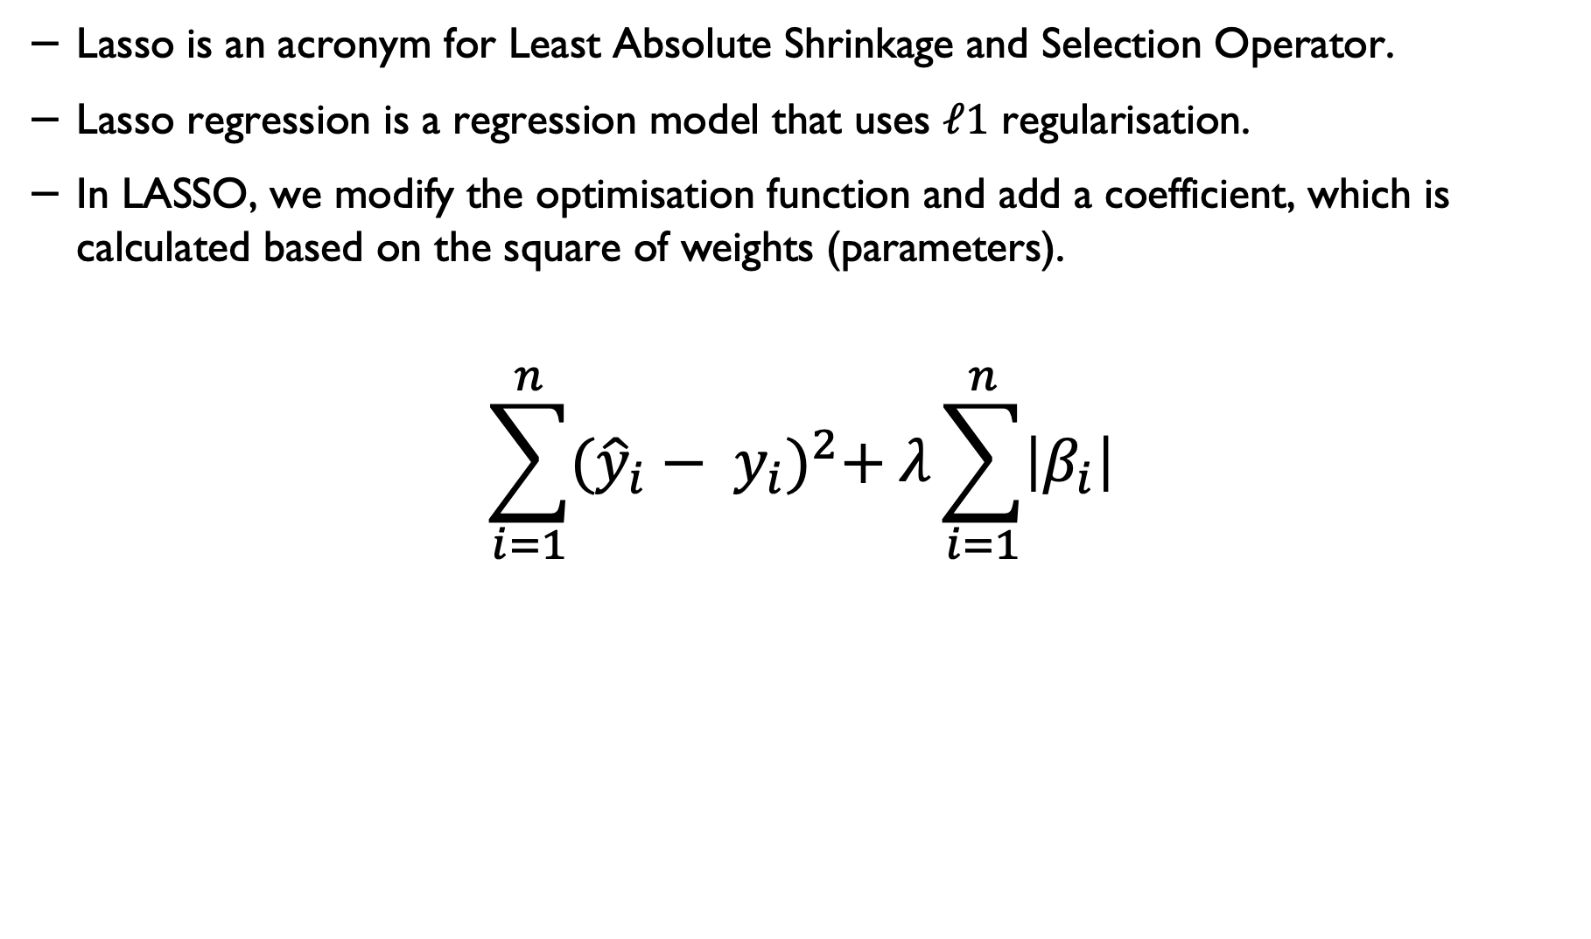
L1 Regularisation (Lasso)*
Lasso is an acronym for Least Absolute Shrinkage and Selection Operator.
Lasso regression is a regression model that uses $ℓ1$ regularisation.
In LASSO, we modify the optimisation function and add a coefficient, which is calculated based on the square of weights (parameters).
$$\sum_{i=1}^{n}{{({\hat{y}}_{i}− y_{i})}^{2}+ λ\sum_{i=1}^{n}{\left|β_{i}\right|}}$$

Slide 17
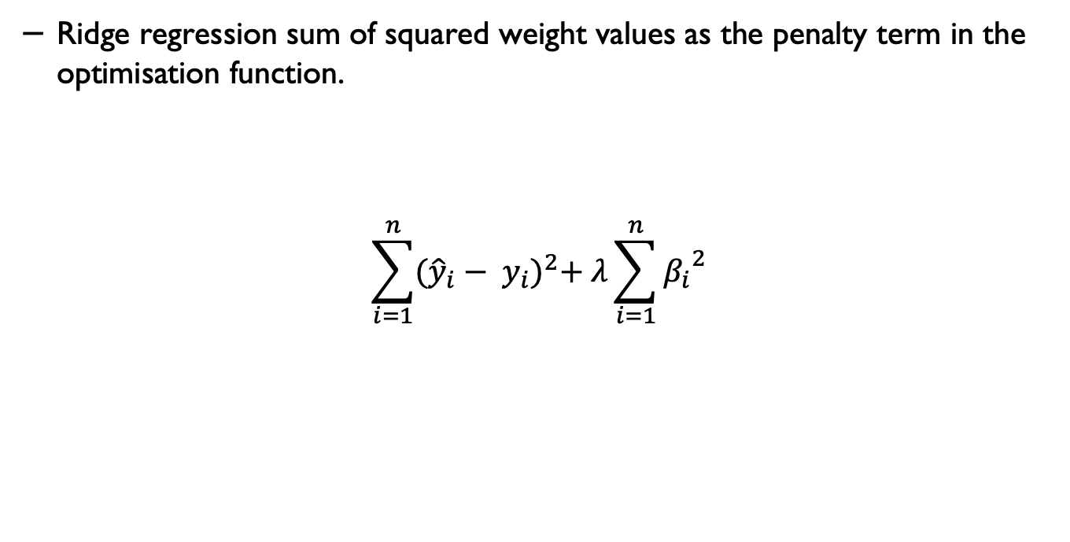
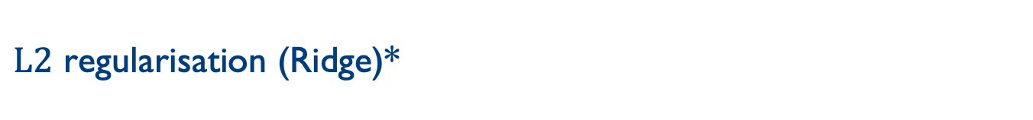
$L2$ regularisation (Ridge)*
Ridge regression sum of squared weight values as the penalty term in the optimisation function.
$$\sum_{i=1}^{n}{{({\hat{y}}_{i}− y_{i})}^{2}+ λ\sum_{i=1}^{n}{{β_{i}}^{2}}}$$

Slide 18
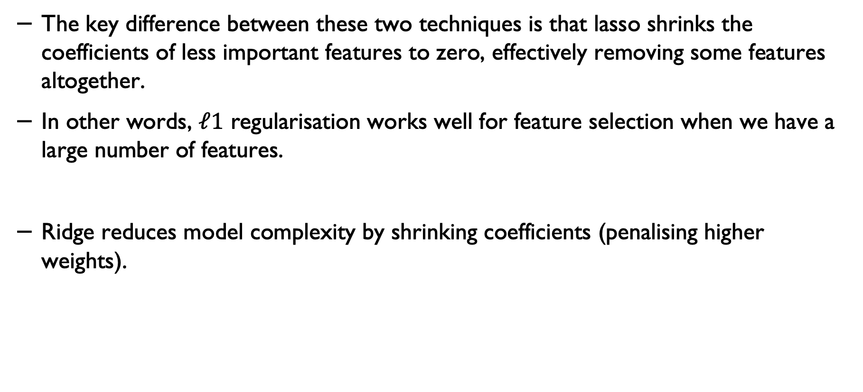
Lasso and Ridge
The key difference between these two techniques is that lasso shrinks the coefficients of less important features to zero, effectively removing some features altogether.
In other words, $ℓ1$ regularisation works well for feature selection when we have a large number of features.
Ridge reduces model complexity by shrinking coefficients (penalising higher weights).

Slide 19
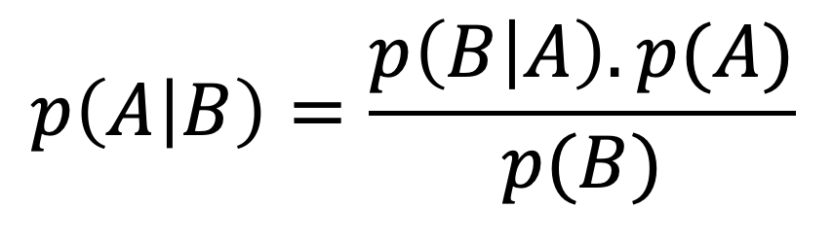
Bayes Rule
Likelihood
Prior
Posterior
$$p\left(A | B\right)=\frac{p\left(B | A\right). p(A)}{p(B)}$$
Marginalisation

Slide 20
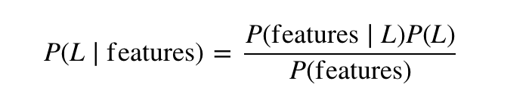
Naïve Bayes
We call it Naïve because it assumes that all the features are independent. In practice, this is not always true – but this assumption allows us to apply the Bayesian theorem:

Slide 21
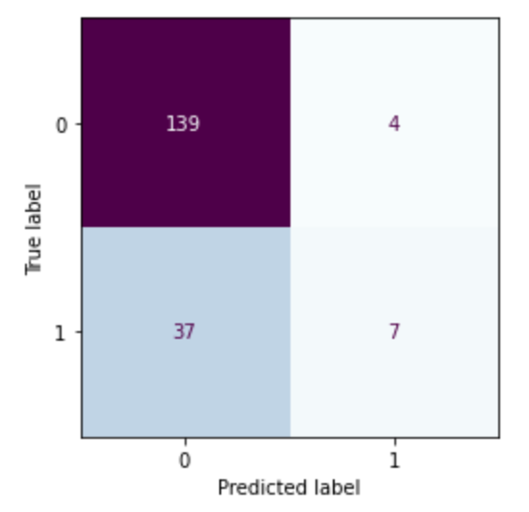
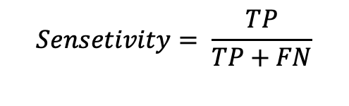
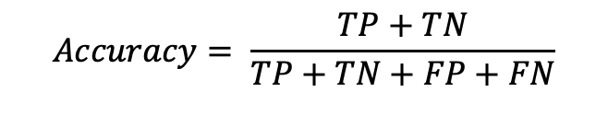
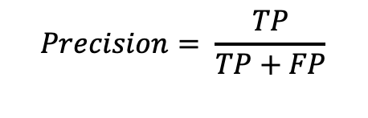
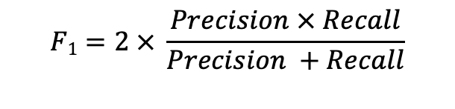
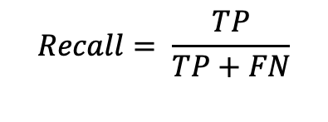
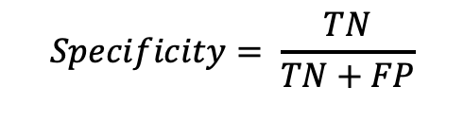
All in one place
$$Precision= \frac{TP}{TP+FP}$$
$$F1=2 × \frac{Precision × Recall}{Precision +Recall}$$
$$Recall= \frac{TP}{TP+FN}$$
$$Accuracy= \frac{TP+TN}{TP+TN+FP+FN}$$
$$Sensetivity= \frac{TP}{TP+FN}$$
$$Specificity= \frac{TN}{TN+FP}$$

Slide 22
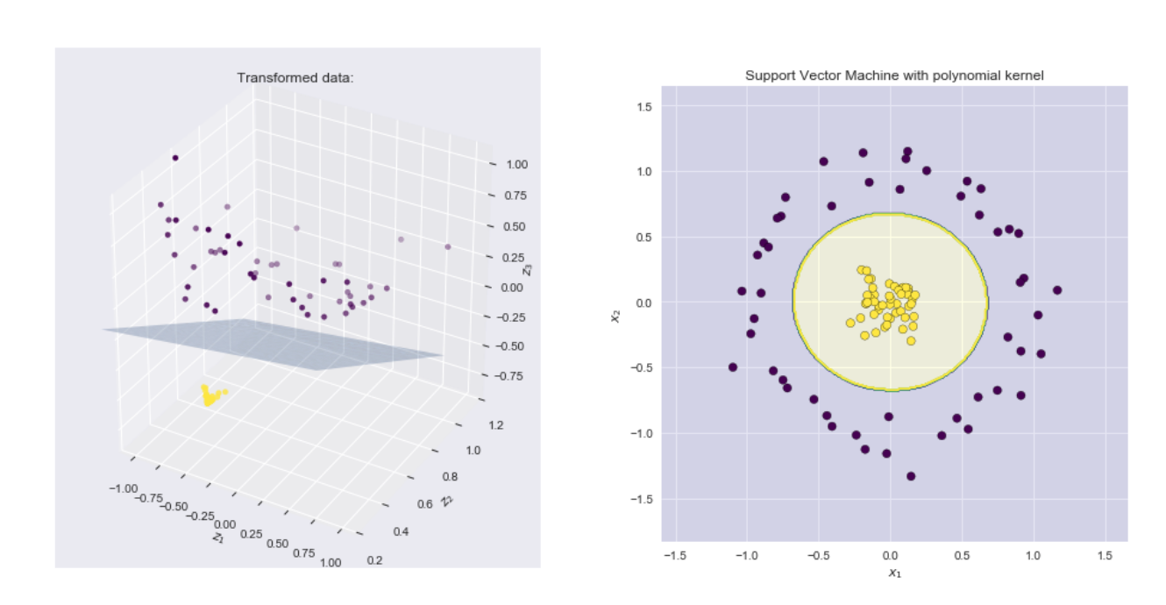
Example – applying polynomial kernel
Source: https://xavierbourretsicotte.github.io/Kernel_feature_map.html

Slide 23
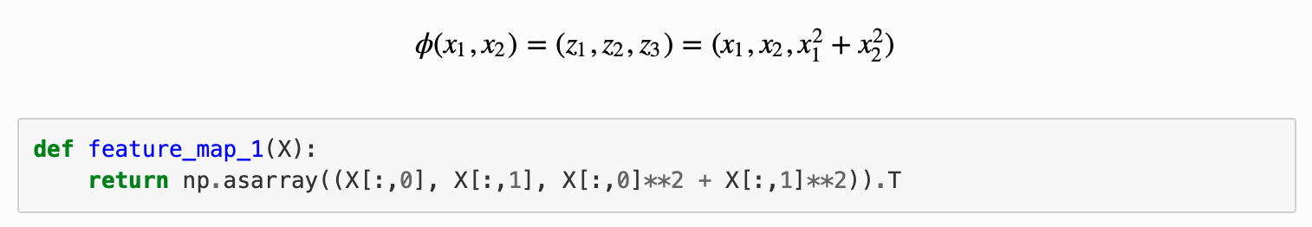
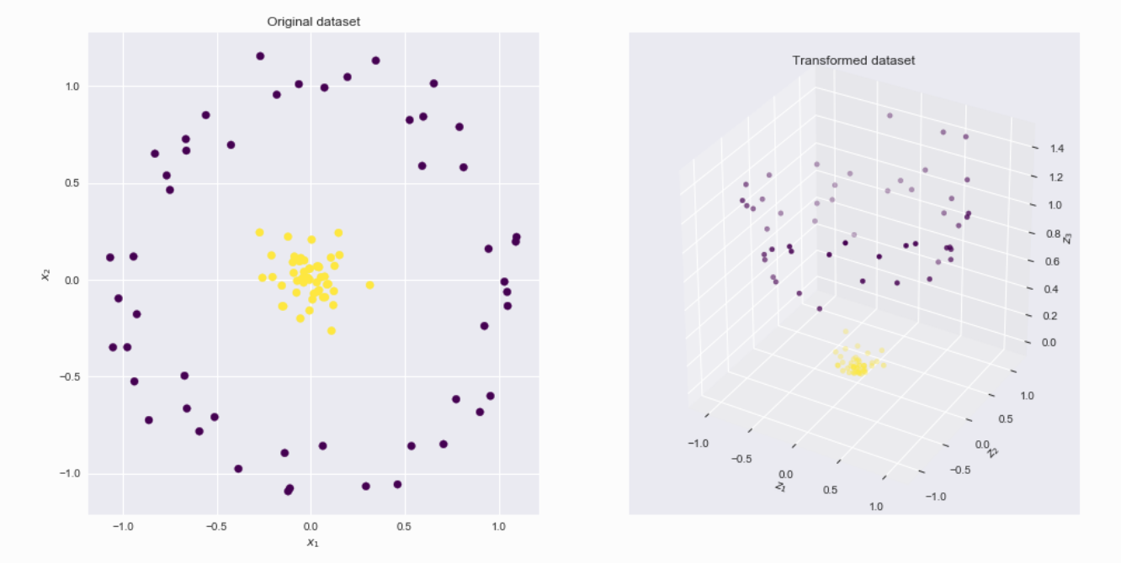
A polynomial kernel
Source: https://xavierbourretsicotte.github.io/Kernel_feature_map.html

Slide 24

Example: SVM for a linearly separable set of 2d-points
Source: https://vovkos.github.io/doxyrest-showcase/opencv/sphinx_rtd_theme/page_tutorial_introduction_to_svm.html

Slide 25
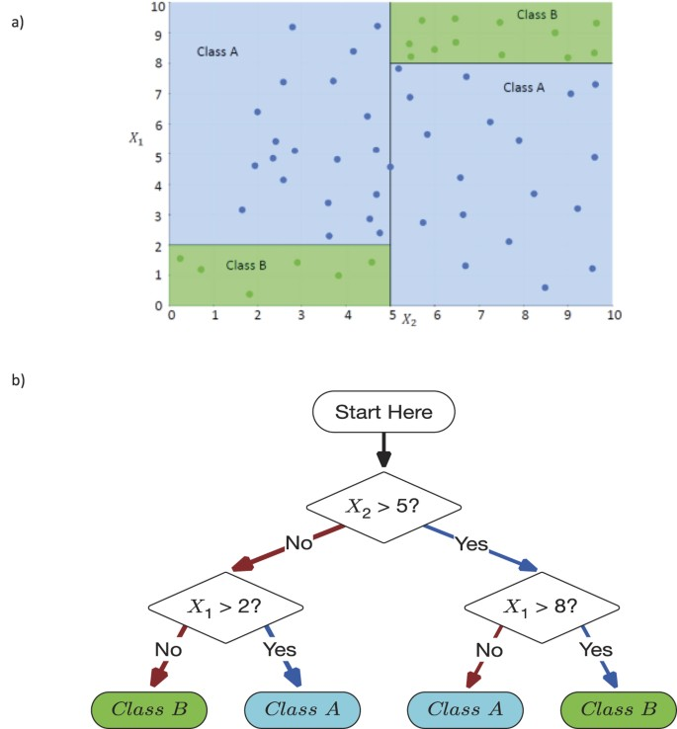
Decision Making Using DTs
Source: Valdes, G., Luna, J., Eaton, E. et al. MediBoost: a Patient Stratification Tool for Interpretable Decision Making in the Era of Precision Medicine. Sci Rep 6, 37854 (2016). https://doi.org/10.1038/srep37854

Slide 26
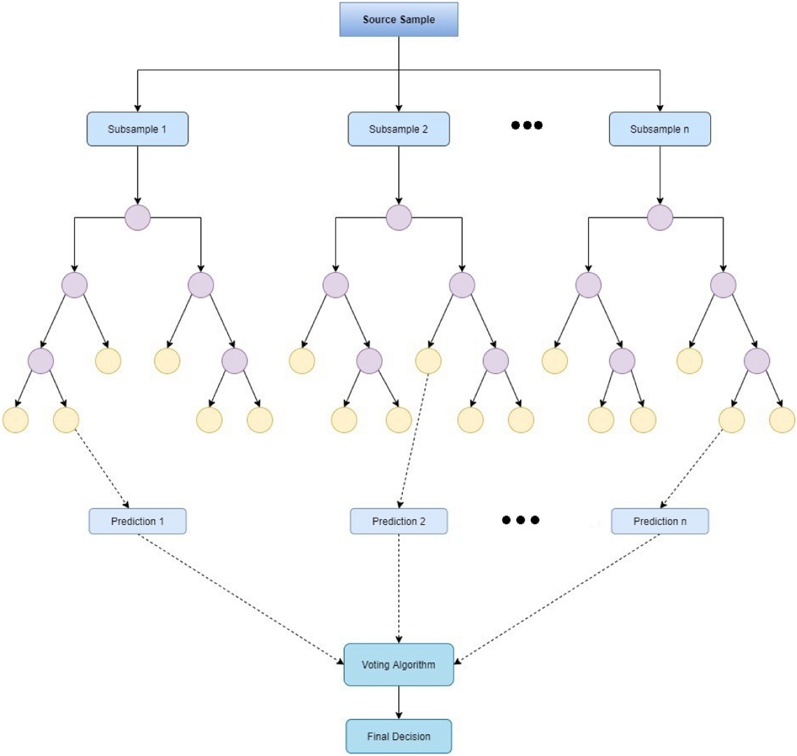
Structure of Random Forests
Source: Malebary, S.J., Khan, Y.D. Evaluating machine learning methodologies for identification of cancer driver genes. Sci Rep 11, 12281 (2021). https://doi.org/10.1038/s41598-021-91656-8

Slide 27
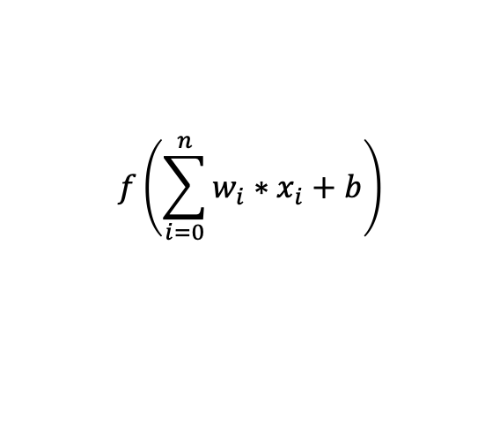
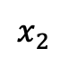
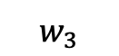
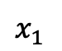
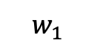
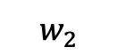
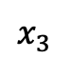
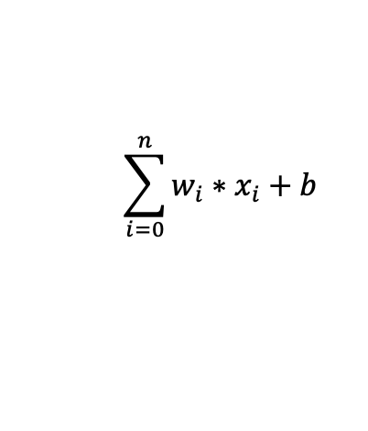
NN with an activation function
b
$$x_{1}$$
$$w_{1}$$
$$w_{2}$$
$$\sum_{i=0}^{n}{w_{i}{∗x}_{i}}+b$$
$$x_{2}$$
y
$$w_{3}$$
$$x_{3}$$
$$f\left(\sum_{i=0}^{n}{w_{i}{∗x}_{i}}+b\right)$$

Slide 28
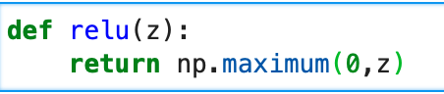
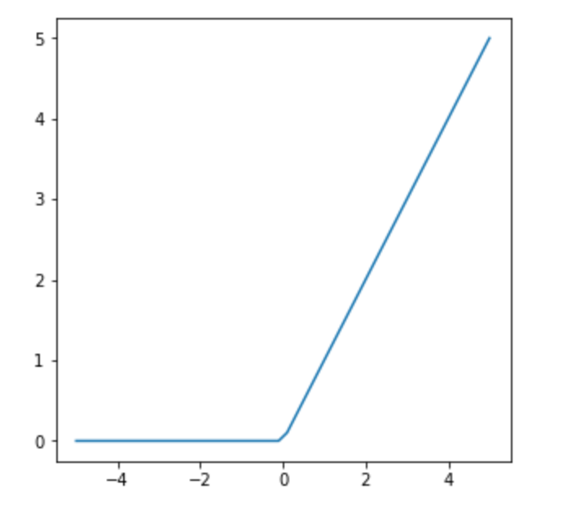
Rectified Linear Units (ReLU)

Slide 29
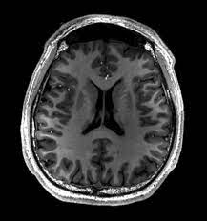
Images a vectors
Using images by flattening the images means overlooking the spatial relation between pixels.
This approach could be a very simple solution to feed the resulting one-dimensional vectors into a fully connected MLP or other probabilistic models.

Slide 30



Example – edge detection: kernel

Slide 31

CNN kernels
$$\left(1×0\right)+\left(2×1\right)+\left(4×2\right)+\left(5×3\right)=25$$
$$\left(4×0\right)+\left(5×1\right)+\left(7×2\right)+\left(8×3\right)=43$$
$$\left(3×0\right)+\left(4×1\right)+\left(6×2\right)+\left(7×3\right)=37$$
Two-dimensional cross-correlation operation. The shaded portions are the first output element as well as the input and kernel tensor elements used for the output computation:
(0×0) + (1×1)+ (3×2)+ (4×3)=19.

Slide 32

Padding: example

Slide 33

Pooling
Like convolutional layers, pooling operators consist of a fixed-shape window that is slid over all regions in the input according to its stride, computing a single output for each location traversed by the fixed-shape window (sometimes known as the pooling window).

Slide 34


Compressed notion for LeNet-5

Slide 35


Autoencoder
Source for the middle image: https://uk.mathworks.com/discovery/autoencoder.html

Slide 36
ML deployments in real-world settings
The systems are often used for decision support and have humans in the loop.
However, the trustworthiness, reliability and robustness of the systems/models must be considered and investigated prior to the deployments.
The users’ perceptions of the system and appropriate training should be also considered.

Slide 37
Responsible and ethical machine learning
Anticipate risks and potential issues
Actively engage and think of solutions
Work with domain experts and learn about the context and conditions of data collection, and the use of system/model.
Create feedback loops (before and after deployment)
Plan for update and maintenance

Slide 38

Hidden technical debt in real-world ML systems
It is important to note that in several applications, only a small fraction of real-world ML systems comprise the ML code.
ML Code
Source: Sculley et al., Hidden Technical Debt in Machine Learning Systems, NeurIPS, 2015.
38

Slide 39


Applications

Slide 40


Neuroscience inspired machine learning
Chavlis, S., Poirazi, P. Dendrites endow artificial neural networks with accurate, robust and parameter-efficient learning. Nat Commun 16, 943 (2025). https://doi.org/10.1038/s41467-025-56297-9

Slide 41


Neuroscience inspired machine learning
“…build a Hodgkin–Huxley (HH) network with rich internal complexity, where each neuron is an HH model, and prove that the dynamical properties and performance of the HH network can be equivalent to a bigger leaky integrate-and-fire (LIF) network, where each neuron is a LIF neuron with simple internal complexity.”
He, L., Xu, Y., He, W. et al. Network model with internal complexity bridges artificial intelligence and neuroscience. Nat Comput Sci 4, 584–599 (2024). https://doi.org/10.1038/s43588-024-00674-9

Slide 42

Machine learning for neurodegenerative conditions

Slide 43


ML in Parkinson’s Disease
Schalkamp, AK., Peall, K.J., Harrison, N.A. et al. Wearable movement-tracking data identify Parkinson’s disease years before clinical diagnosis. Nat Med 29, 2048–2056 (2023). https://doi.org/10.1038/s41591-023-02440-2

Slide 44


ML in Dementia Care
Walsh, C., Capstick, A., Fletcher-Lloyd, N. et al. Longitudinal study of care needs and behavioural changes in people living with dementia using in-home assessment data. Commun Med 5, 14 (2025). https://doi.org/10.1038/s43856-024-00724-3

Slide 45


ML in comorbidities associated with neurodegenerative conditions
Bafaloukou, Marirena et al. , An interpretable machine learning tool for in-home monitoring of agitation episodes in people living with dementia: a proof-of-concept study, eClinicalMedicine, Volume 80, 103032

Slide 46
Review Questions

Slide 47
Q1
What machine learning libraries you have worked with before?

Slide 48
Q2
What is the difference between L1 and L2 norms for regularisation and when you use them.

Slide 49
Q3
If you have a dataset with an imbalanced number of samples, how do you deal with this problem?

Slide 50
Q4
If we give you a set of data (imagine imaging data or electronic healthcare records) and ask you to design a machine learning model. Where and how would you start designing your model?

Slide 51
Q5
If you are given a dataset, how do you decide which model would be the most efficient model to solve your problem?

Slide 52
Q6
Suppose you are given a dataset to cluster. How do you decide what number of clusters would be the most suitable for the dataset?

Slide 53
Q7
How would you ensure the model you designed is not overfitted?

Slide 54
If you have any questions
Please feel free to arrange a meeting or email (p.barnaghi@imperial.ac.uk).
To arrange a meeting, please email my colleague, Ms Rhiannon Kirby.
My office: 928, Sir Michael Uren Research Hub, White City Campus.

